Slide 1
Activating creativity & innovation
Skills for Success for Learning Professionals

Slide 2
Objectives for today
Objectives
Agenda
Upon completion of this workshop you will be able to:
Describe how creativity & innovation can benefit your teams, managers, leaders and organization
Identify organizational barriers to creativity & innovation
Discuss organizational structures required to support creativity & innovation
Identify approaches for development at various levels
Identify key resources to support your implementation plan
About the Skills for Success
About creativity & innovation
According to ESDC
In the research
In organizations
Strategies for increasing creativity & innovation
Additional resources
Issuing badges
Wrap up & close

Slide 3
About skills for success

Slide 4
About Skills for Success
The Government of Canada has identified a framework of critical Skills for Success that are:
The skills needed to participate and thrive in learning, work and life
For everyone – employers, workers, training providers, governments, and communities
The SFS Program:
Helps Canadians access online tools to assess their skills needs, and
Funds skills development projects, including assessment and training tools

Slide 5
About I4PL’s role in the initiative
The purpose of I4PL is to elevate the performance of the Canadian workforce.
I4PL partnered with ESDC to:
Conduct an extensive research project around three of the skills:
Creativity & innovation
Collaboration, and
Creativity & Innovation
Develop workshops to enable L&D professionals to build Skills for Success in the workplace.

Slide 6
About Creativity & innovation

Slide 7
Creativity & innovation in the research: definitions
Creativity & innovation…
Creativity and innovation are related but also different
Few articles indicated that creativity is teachable, but it is coachable
Performance-oriented individuals less likely to show creativity
Organizational norms, leadership, structure, rewards and play a role
Reflections (during workshop)

Slide 8
Creativity & innovation in the research: definitions
Creativity
Innovation
Creativity means generating ideas that are both new and useful, a result of solving challenging problems (Leung et al., 2014; Birdi, 2007), (Amabile (1996) in Bjorkman, 2004))
Creativity can be an individual or socially-influenced experience within a person’s control (Birdi, 2007)
Innovation refers to implementing useful ideas (Puccio, 2005)
Innovation requires social processes of negotiating and influencing to gain the acceptance and resources needed to put ideas into practice (Birdi, 2007)
Notes:
FACILITATOR 1
creativity & innovation in the research 1 min
Do
[click] to reveal each definition in turn
Walk through the points
Creativity may also include other requirements such as being appropriate to the context, or being valued and accepted by a community (Watson, 2007).
Transition to ESDC definition

Slide 9
Creativity & innovation
Use your imagination and curiosity
Facilitate a creative & innovative environment
Identify opportunities for you to innovate
Your ability to imagine, develop, express, encourage, and apply ideas in ways that are novel, unexpected, or challenge existing methods and norms.
Apply your ideas
Generate ideas that are novel to yourself or others
Develop your ideas

Slide 10
Creativity & innovation
Imagine different situations and possibilities
Show interest in learning and applying new things
Seek a wide range of stimuli and experiences
Be open to new ideas without judging and setting limitations
Use your imagination and curiosity
Challenge norms, habits, and preconceptions where appropriate
Identify artificial constraints
Identify opportunities to innovate
Deviate from existing processes, thinking, and approaches
Use an inquisitive approach. For example: ask questions even when there is no obvious answer
Seek patterns where patterns may not be readily apparent. For example: combine unrelated attributes
Acknowledge and work with uncertainty and unpredictability.
Generate ideas that are novel to yourself or others
Reverse ideas and approaches to see if the opposite is true
Expand on ideas and approaches
Develop your ideas
Act on the creative ideas and approaches to make tangible and useful contributions
Expect failures
Learn from failures to improve
Apply your ideas
Encourage habits and behaviors that facilitate creativity and innovation in yourself and others, for example: lightheartedness, playful approach, healthy competition
Support and motivate others to be creative by coaching and sharing tools, information, and ideas
Facilitate a creative & innovative environment

Slide 11
Creativity & innovation proficiency levels
Proficiency levels are the level at which a person demonstrates a particular skill.
Entry level
You can generate a limited number of novel ideas under guidance and support.
You are open to applying new ideas, but are quick to revert to norms and habits when the new ideas fail or face uncertainties
Intermediate level
You can generate a larger number of novel ideas on your own.
You acknowledge and work with uncertainties, accept failures, and learn from failures to improve your ideas.
You are receptive to new ideas from others
Advanced level
You can generate a wider range of novel ideas, with diverse dimensions of originality.
You evaluate limitations of novel ideas and find ways to improve them to minimize failures and uncertainties.
You facilitate an environment for others to be creative & innovative.

Slide 12
Creativity & innovation in the research: requirements
Divergent thinking
Measures include:
Flexibility: variety of sources for ideas
Originality: unusualness of ideas
Fluency: quantity of ideas
Elaboration: development or embellishing of ideas
Convergent thinking
Includes:
Evaluating: using criteria to assess ideas
Choosing: choosing the best idea for the desired result
Implementation
Requires:
A structured process of identifying and engaging with stakeholders to secure input, support and resources for implementation
Notes:
FACILITATOR 1
C&I requirements in the research 3 min
Points
A little more on the difference between divergent and convergent thinking and implementation…
[click] to reveal divergent
[click] to reveal convergent
[click] to reveal implementation
Transition
So we’ve heard a lot of definitions, but what does that mean in real life?

Slide 13
When creativity & innovation is needed
Thinking about your organization and your team:
What innovation is needed to support the organizational strategy?
What are some situations where creativity & innovation might be valued?
What are some situations where creativity & innovation should NOT be a priority?
Team / Division / Organization | What are some situations where creativity & innovation might be valued? | What are some situations where creativity & innovation should NOT be a priority?

Slide 14
How creativity & innovation benefits…
Individuals
Teams
Organization
Managers and leaders

Slide 15
How creativity & innovation benefits…
Greater sense of control and pride
Less stress
Increased resilience
Higher engagement
Improved self-expression
Improved problem-solving
Stronger relationships
Greater collaboration and engagement
Increased productivity
Individuals
Teams
Organization
Managers and leaders
Market leadership
Speed to market
Talent attraction
Increased productivity
Reduced costs
Improved problem-solving
Fewer difficult conversations
Higher engagement
Better team dynamics
Opportunity to be coach and leader

Slide 16
Supporting Creativity & innovation

Slide 17
Supporting creativity & innovation
Organization | What organizational structures get in the way? | How could you overcome these barriers?
Leaders | What must leaders do to support creativity & innovation? | What are some options to develop those capabilities?
Managers | What must managers do to support creativity & innovation? | What are some options to develop those capabilities?

Slide 18
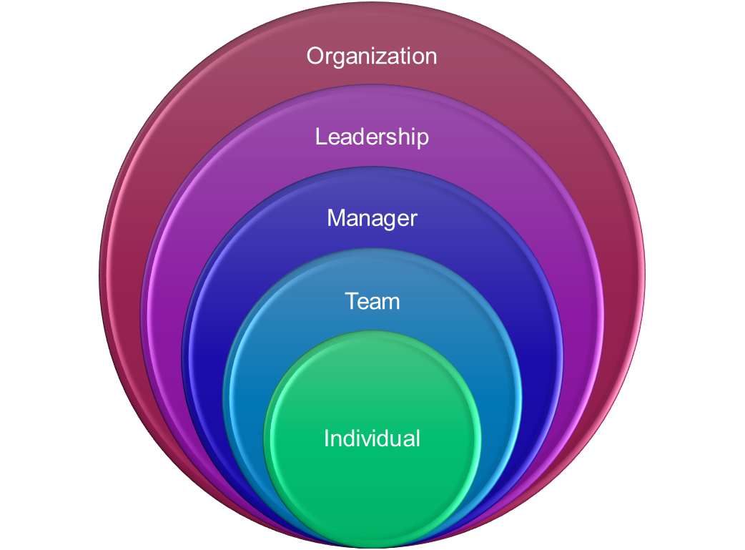
Supporting creativity & innovation
Leaders
Managers
Some examples include:
Communicate plans and strategies
Ask for input and ideas
Respond to and reward suggestions
Act on suggestions
Reward mistakes and learning
Similar to leaders plus:
Coach whenever possible
Set and refine goals together
Link goals and tasks to strategy
Offer choice and autonomy/support as needed
Support prioritization
Check in regularly
18

Slide 19
Developing Creativity & innovation

Slide 20
Creativity & innovation in the research: individuals
People approach creative problem-solving with habits and preferences (Puccio, 2005)
Differences may arise from personality, motivation (Batey 2011), expertise, or experiences of problem-solving (Napier & Usui, 2008)
Differences also arise based on context such as industry, job, experience (Napier & Usui, 2008)
Problem-solving styles
Generators | Focus on discovering problems and looking for facts (divergence)
Conceptualizers | Focus on defining a problem and finding useful ideas (divergence)
Optimizers | Focus on evaluating and selecting ideas, and planning (convergence)
Implementors | Focus on gaining acceptance of an idea and putting it into action (convergence)
Goal orientation and priorities
Learning orientation | prioritizes seeking and processing information to enhance understanding to solve problems
Performance approach | prioritizes gaining praise and recognition
Performance avoidance | prioritizes avoiding mistakes and criticism

Slide 21
Creativity & innovation
Imagine different situations and possibilities
Show interest in learning and applying new things
Seek a wide range of stimuli and experiences
Be open to new ideas without judging and setting limitations
Use your imagination and curiosity
Techniques for divergent thinking
Brainstorming: suggest ideas without judgment, being as wild as possible, and building on suggestions from others
Brainwriting: each person writes ideas on paper, circulates their paper, then on someone else’s paper writes reactions to their ideas and builds on and embellishes them
Morphological analysis: break a problem into parts, steps or individuals, then reconfigure those parts
References
In I4PL article to be published

Slide 22
Creativity & innovation
Imagine different situations and possibilities
Show interest in learning and applying new things
Seek a wide range of stimuli and experiences
Be open to new ideas without judging and setting limitations
Use your imagination and curiosity
Individual
Managers
Leaders
Organization

Slide 23
Creativity & innovation
Challenge norms, habits, and preconceptions where appropriate
Identify artificial constraints
Identify opportunities to innovate
Additional techniques for divergent thinking
Synectics: identify the current problem, identify similar (analogical) problems in other domains, then apply lessons from them
Morphological analysis: break a problem into parts, steps or individuals, then reconfigure those parts
Lateral thinking: shift perspective by smashing assumptions, looking for alternatives, generating opposite viewpoints
References
In I4PL article to be published

Slide 24
Creativity & innovation
Challenge norms, habits, and preconceptions where appropriate
Identify artificial constraints
Identify opportunities to innovate
Individual
Managers
Leaders
Organization

Slide 25
Creativity & innovation
Deviate from existing processes, thinking, and approaches
Use an inquisitive approach. For example: ask questions even when there is no obvious answer
Seek patterns where patterns may not be readily apparent. For example: combine unrelated attributes
Acknowledge and work with uncertainty and unpredictability.
Generate ideas that are novel to yourself or others
Design thinking
Core features of design thinking include the abilities to:
Deal with different types of design problems, especially ill-defined and 'wicked' problems
Adopt solution-focused strategies
Use abductive and productive reasoning
Employ non-verbal, graphic/spatial modelling media, for example, sketching and prototyping
References
https://en.wikipedia.org/wiki/Design_thinking

Slide 26
Creativity & innovation
Deviate from existing processes, thinking, and approaches
Use an inquisitive approach. For example: ask questions even when there is no obvious answer
Seek patterns where patterns may not be readily apparent. For example: combine unrelated attributes
Acknowledge and work with uncertainty and unpredictability.
Generate ideas that are novel to yourself or others
Individual
Managers
Leaders
Organization

Slide 27
Creativity & innovation
Reverse ideas and approaches to see if the opposite is true
Expand on ideas and approaches
Develop your ideas
Reverse brainstorming
Identify the problem or challenge, like “increase productivity.”
Pose a reverse brainstorming question, like “How can we intentionally reduce productivity within our team?” to prompt creative thinking.
Team members generate ideas that'll make the problem worse.
Analyze each idea to determine the underlying causes.
Reverse! Flip the negative ideas into positive solutions.
Produce effective potential solutions for your initial problem statement.
References
https://www.mural.co/blog/reverse-brainstorming

Slide 28
Creativity & innovation
Reverse ideas and approaches to see if the opposite is true
Expand on ideas and approaches
Develop your ideas
Individual
Managers
Leaders
Organization

Slide 29
Creativity & innovation
Act on the creative ideas and approaches to make tangible and useful contributions
Expect failures
Learn from failures to improve
Apply your ideas
Learning from mistakes: Six questions
What is the decision you’re facing now?
What is it about the current decision that is stressful for you, and what is your go-to approach for solving it?
What are one or two previous decisions that you want to learn from? What didn’t go well? Why do you think it didn’t go well?
With 20/20 hindsight, what assumptions did you make that might have contributed to the outcome?
How might you apply your learning to the current decision you face?
What is your solution now?
References
https://hbr.org/2024/09/how-to-learn-from-your-mistakes-and-make-better-decisions

Slide 30
Creativity & innovation
Act on the creative ideas and approaches to make tangible and useful contributions
Expect failures
Learn from failures to improve
Apply your ideas
Individual
Managers
Leaders
Organization

Slide 31
Creativity & innovation
Encourage habits and behaviors that facilitate creativity and innovation in yourself and others, for example: lightheartedness, playful approach, healthy competition
Support and motivate others to be creative by coaching and sharing tools, information, and ideas
Facilitate a creative & innovative environment
Fostering a Culture of Psychological Safety
Creating an environment where individuals feel safe to take risks and express unconventional ideas without fear of criticism encourages experimentation and innovation
Psychological safety is a key factor in promoting creative contributions within teams
References
Identity-based motivation
https://psychsafety.com/about-psychological-safety/

Slide 32
Creativity & innovation
Encourage habits and behaviors that facilitate creativity and innovation in yourself and others, for example: lightheartedness, playful approach, healthy competition
Support and motivate others to be creative by coaching and sharing tools, information, and ideas
Facilitate a creative & innovative environment
Individual
Managers
Leaders
Organization

Slide 33
Skills for success resources

Slide 34
Skills for Success Resources
Resource | Link
Skills for Success website | https://www.canada.ca/en/services/jobs/training/initiatives/skills-success.html
Definitions, components and behaviours | https://www.canada.ca/en/services/jobs/training/initiatives/skills-success/learning-steps.html#creativity
Searchable assessment and training tools | https://www.canada.ca/en/services/jobs/training/initiatives/skills-success/tools.html?category=Individual&type=Training
Post-learning assessment | https://immplus.ca/snapshot/
Practitioner tools & resources | https://sfs-tools.ca/
UP Skills for Work resources | https://upskillsforwork.ca/resources/
I4PL Resources | The powerpoint and workbook will be hosted on a microsite for your future use.

Slide 35
Skills for success badges

Slide 36
Learning Provider badge
You can proudly post this badge, and gain 8 continuing education credits for this program.
Two requirements:
Participation in this workshop
Completion of a small assignment detailing your implementation plan
Visit CanCred to provide responses to the following :
The greatest benefit my organization will enjoy as a result of improved Creativity & innovation is…
Our most significant organizational barriers to developing Creativity & innovation are…
The organizational structures we need to address to support Creativity & innovation are…
My plan for increasing Creativity & innovation in my organization
PDF file upload
Be sure to identify approaches for development at various levels

Slide 37
Issuing badges to your learners
The programs you implement should ensure learners are able to:
Articulate the benefits of Creativity & innovation for their team, the organization and themselves
Identify individual barriers to developing creativity & innovation
Determine what is needed to support creativity & innovation
Develop strategies for being more creative & innovative in various situations
Suggested learning experiences include:
An interactive workshop which provides:
Key concepts and applications for the workplace
Practical activities to apply the concepts in real-life scenarios
Opportunities to work with others in the development of the skill
Follow up activities that enable learners to apply the skill with support from their manager
Submission of a personal action plan
Direct learners to CanCred using the access code: wsnbiayxx5wa
Learners apply for their badges by providing their name and responses to the following:
My most significant barriers to developing Creativity & innovation are…
My #1 strategy for being more creative & innovative is…

Slide 38
Committing to Creativity & innovation
What is one thing you will do differently after today?
Reflections

Slide 39
Thank you
from all of us at I4PL

