Slide 1
Activating collaboration
Skills for Success for Learning Professionals

Slide 2
Objectives for today
Objectives
Agenda
Upon completion of this workshop you will be able to:
Describe how collaboration can benefit your teams, managers, leaders and organization
Identify organizational barriers to collaboration
Discuss organizational structures required to support collaboration
Identify approaches for development at various levels
Identify key resources to support your implementation plan
About the Skills for Success
About collaboration
According to ESDC
In the research
In organizations
Strategies for increasing collaboration
Additional resources
Issuing badges
Wrap up & close
2

Slide 3
About skills for success

Slide 4
About Skills for Success
The Government of Canada has identified a framework of critical Skills for Success that are:
The skills needed to participate and thrive in learning, work and life
For everyone – employers, workers, training providers, governments, and communities
The SFS Program:
Helps Canadians access online tools to assess their skills needs, and
Funds skills development projects, including assessment and training tools

Slide 5
About I4PL’s role in the initiative
The purpose of I4PL is to elevate the performance of the Canadian workforce.
I4PL partnered with ESDC to:
Conduct an extensive research project around three of the skills:
Collaboration
Collaboration, and
Creativity & Innovation
Develop workshops to enable L&D professionals to build Skills for Success in the workplace.

Slide 6
About Collaboration

Slide 7
Collaboration in the research
Collaboration…
Affected by individuals, and team and organizational structure, hence must be addressed at all levels
Important to ease barriers to collaboration, such as access to information, foster interpersonal trust, create clear shared goals, define clear outcomes and structures
Reflections (during workshop)

Slide 8
Collaboration
Work well with other people
Reflect and improve on teamwork
Value diversity and inclusivity of others
Your ability to contribute and support others to achieve a common goal.
Achieve a common goal with others
Manage difficult interactions with other people
Facilitate an environment where you can collaborate with others

Slide 9
Collaboration
Engage in trust building behaviours
Adhere to social and organizational rules. For example: be on time
Encourage supportive and cooperative behaviours, language, attitudes, and approaches
Assess strengths and weaknesses of yourself and others
Work well with other people
Understand that people from different cultures, backgrounds, and abilities can have different customs, values, and ways of thinking and acting
Acknowledge and accept differences among people
Respond without judging
Adapt to different styles of interaction when possible and appropriate
Value diversity and inclusivity of others
Engage in productive discussions
Anticipate and address interpersonal barriers
Discuss, negotiate, and resolve difficult interactions in a sensitive and helpful manner
Manage difficult interactions with other people
Acknowledge roles of yourself and others
Understand and adapt to needs, strengths, and weaknesses of others
Support others through coaching, mentoring, and motivating
Facilitate an environment where you can collaborate with others
Take responsibility to make contributions and complete tasks
Consult and share with others when needed and appropriate
Ensure opportunities for others to contribute
Assess and mitigate risks and manage resources. For example: via system thinking
Achieve a common goal with others
Reflect on team performance
Make constructive suggestions for improvement
Use feedback constructively
Reflect and improve on teamwork

Slide 10
Collaboration proficiency levels
Proficiency levels are the level at which a person demonstrates a particular skill.
Entry level
You can interact with familiar people or a small number of diverse unfamiliar people to share information to complete routine independent tasks.
You can maintain cooperative respectful behaviours toward others and minimize conflict.
Intermediate level
You can work with familiar and diverse unfamiliar groups of people to coordinate tasks or work together to achieve simple or well-defined goals.
You can support and adapt to others when appropriate and manage conflicts when needed.
Advanced level
You can work in large teams of diverse people to achieve complex goals that might involve unpredictable situations.
You can take on responsibility for:
integrating work
coaching and motivating others
managing conflicts, and
evaluating and improving teamwork

Slide 11
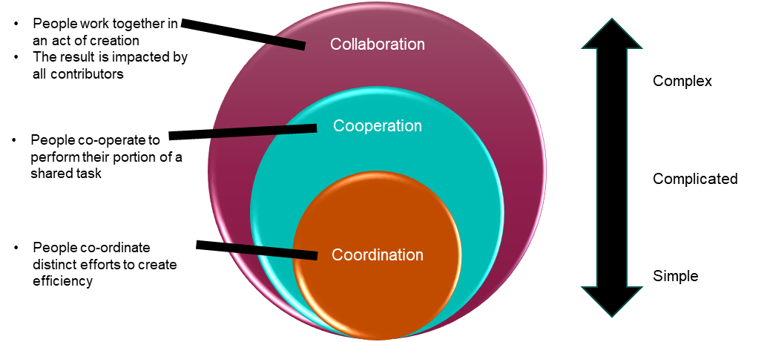
When collaboration is needed
Thinking about your organization and your team:
What are some situations where collaboration might be beneficial?
What level of collaboration is needed?
Team / Division / Organization | Changes or situations where collaboration required | Level of collaboration required

Slide 12
How collaboration benefits…
Individuals
Teams
Organization
Managers and leaders

Slide 13
How collaboration benefits…
Skill development
Increased efficiency
Better problem-solving
Better workplace relationships
Greater job satisfaction
Improved career opportunities
Stronger relationships
Improved communication
Less conflict
Greater creativity & innovation
Higher adaptability & agility
Individuals
Teams
Organization
Managers and leaders
Increased creativity & innovation
Higher engagement & retention
Better public image
Increased productivity & efficiency
Reduced costs
Enhanced customer experience
Better decision-making
Lower resistance
Higher engagement
Greater delegation &trust
Better team performance
Opportunity to be coach and leader

Slide 14
Supporting Collaboration

Slide 15
Supporting collaboration
Organization | What organizational structures get in the way? | How could you overcome these barriers?
Leaders | What must leaders do to support collaboration? | What are some options to develop those capabilities?
Managers | What must managers do to support collaboration? | What are some options to develop those capabilities?

Slide 16
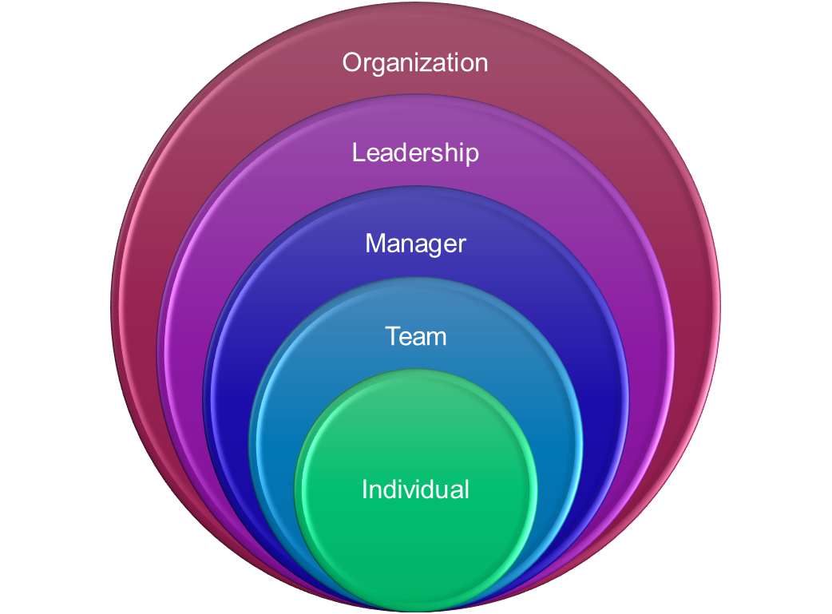
Supporting collaboration
Leaders
Managers
Some examples include:
Lead by example
Share stories
Reward mistakes and learning
Communicate plans and strategies
Solicit input and feedback, broadly and often
Similar to leaders plus:
Coach whenever possible
Adapt to the individual
Set and refine goals together
Link goals and tasks to strategy
Offer choice and autonomy/support as needed
Demonstrate consistency
Minimize distractions
Support prioritization
Support self-improvement
Check in regularly
16

Slide 17
Developing Collaboration

Slide 18
Collaboration in the research
Mix of individual and team development, supported by managers, leaders, structures, etc.
Each person/role has its own skills, resources, priorities, and bosses that may conflict with each other (Ashkenas, 2015)
Critical ingredients include:
Trust
Relationship building
Conflict management
Some things that have been working
Experiential learning
Practice and making errors, then using those errors to refine approach
Speed dating approach
Cooperative learning

Slide 19
Collaboration
Engage in trust building behaviours
Adhere to social and organizational rules. For example: be on time
Encourage supportive and cooperative behaviours, language, attitudes, and approaches
Assess strengths and weaknesses of yourself and others
Work well with other people
Trust-building exercises
Team activities that require trust, opportunity to fail and learn, e.g. trust falls
Strengths Development Interventions
Individual and team level assessments and programs focused on identifying, developing, and utilizing employees' strengths have been shown to stimulate personal growth initiative and team interactions
ward self-improvement, leading to increased engagement and job satisfaction.
References
Strengths development
https://bpspsychub.onlinelibrary.wiley.com/doi/10.1111/joop.12240

Slide 20
Collaboration
Engage in trust building behaviours
Adhere to social and organizational rules. For example: be on time
Encourage supportive and cooperative behaviours, language, attitudes, and approaches
Assess strengths and weaknesses of yourself and others
Work well with other people
Individual
Managers
Leaders
Organization

Slide 21
Collaboration
Understand that people from different cultures, backgrounds, and abilities can have different customs, values, and ways of thinking and acting
Acknowledge and accept differences among people
Respond without judging
Adapt to different styles of interaction when possible and appropriate
Value diversity and inclusivity of others
Value and leverage diversity
Individual learning to raise awareness and appreciation of others’ input
Adapt to styles
Individual style assessments and workshops or coaching to apply the findings
Team-building activities based on styles to explore ways to adapt, better communicate and leverage strengths

Slide 22
Collaboration
Understand that people from different cultures, backgrounds, and abilities can have different customs, values, and ways of thinking and acting
Acknowledge and accept differences among people
Respond without judging
Adapt to different styles of interaction when possible and appropriate
Value diversity and inclusivity of others
Individual
Managers
Leaders
Organization

Slide 23
Collaboration
Engage in productive discussions
Anticipate and address interpersonal barriers
Discuss, negotiate, and resolve difficult interactions in a sensitive and helpful manner
Manage difficult interactions with other people
Communication and conflict resolution
Individual approaches to build communication, negotiation and conflict resolution skills
Targeted or team approaches to effective discussion, debate, and overcoming barriers

Slide 24
Collaboration
Engage in productive discussions
Anticipate and address interpersonal barriers
Discuss, negotiate, and resolve difficult interactions in a sensitive and helpful manner
Manage difficult interactions with other people
Individual
Managers
Leaders
Organization

Slide 25
Collaboration
Acknowledge roles of yourself and others
Understand and adapt to needs, strengths, and weaknesses of others
Support others through coaching, mentoring, and motivating
Facilitate an environment where you can collaborate with others
Create common goals
Team activity to align goal with organization or division strategy
Solicit input on goal and steps to achieve it

Slide 26
Collaboration
Acknowledge roles of yourself and others
Understand and adapt to needs, strengths, and weaknesses of others
Support others through coaching, mentoring, and motivating
Facilitate an environment where you can collaborate with others
Individual
Managers
Leaders
Organization

Slide 27
Collaboration
Take responsibility to make contributions and complete tasks
Consult and share with others when needed and appropriate
Ensure opportunities for others to contribute
Assess and mitigate risks and manage resources. For example: via system thinking
Achieve a common goal with others
Create common goals
Team activity to align goal with organization or division strategy
Solicit input on goal and steps to achieve it

Slide 28
Collaboration
Take responsibility to make contributions and complete tasks
Consult and share with others when needed and appropriate
Ensure opportunities for others to contribute
Assess and mitigate risks and manage resources. For example: via system thinking
Achieve a common goal with others
Individual
Managers
Leaders
Organization

Slide 29
Collaboration
Reflect on team performance
Make constructive suggestions for improvement
Use feedback constructively
Reflect and improve on teamwork
Evaluation and feedback
Individual development on evaluation, feedback and coaching
Team lessons learned, do more, do better

Slide 30
Collaboration
Reflect on team performance
Make constructive suggestions for improvement
Use feedback constructively
Reflect and improve on teamwork
Individual
Managers
Leaders
Organization

Slide 31
Skills for success resources

Slide 32
Skills for Success Website
Resource | Link
Skills for Success website | https://www.canada.ca/en/services/jobs/training/initiatives/skills-success.html
Definitions, components and behaviours | https://www.canada.ca/en/services/jobs/training/initiatives/skills-success/learning-steps.html#collaboration
Searchable assessment and training tools | https://www.canada.ca/en/services/jobs/training/initiatives/skills-success/tools.html?category=Individual&type=Training
Post-learning assessment | https://immplus.ca/snapshot/
Practitioner tools & resources | https://sfs-tools.ca/
UP Skills for Work resources | https://upskillsforwork.ca/resources/
I4PL Resources | The powerpoint and workbook will be hosted on a microsite for your future use.

Slide 33
Skills for success badges

Slide 34
Learning Provider badge
You can proudly post this badge, and gain 8 continuing education credits for this program.
Two requirements:
Participation in this workshop
Completion of a small assignment detailing your implementation plan
Visit CanCred to provide responses to the following:
The greatest benefit my organization will enjoy as a result of improved Collaboration is…
Our most significant organizational barriers to developing Collaboration are…
The organizational structures we need to address to support Collaboration are…
My plan for increasing Collaboration in my organization
PDF file upload
Be sure to identify approaches for development at various levels

Slide 35
Issuing badges to your learners
The programs you implement should ensure learners are able to:
Articulate the benefits of Collaboration for their team, the organization and themselves
Identify individual barriers to developing collaboration
Determine what is needed to support collaboration
Develop strategies for being more collaborative in various situations
Suggested learning experiences include:
An interactive workshop which provides:
Key concepts and applications for the workplace
Practical activities to apply the concepts in real-life scenarios
Opportunities to work with others in the development of the skill
Follow up activities that enable learners to apply the skill with support from their manager
Submission of a personal action plan
Direct learners to CanCred using the access code: tegmef636hb2
Learners apply for their badges by providing their name and responses to the following:
My most significant barriers to developing Collaboration are…
My #1 strategy for being more collaborative is…

Slide 36
Committing to Collaboration
What is one thing you will do differently after today?
Reflections

Slide 37
Thank you
from all of us at I4PL

